Slide 1
Streams and File I/O
Chapter 9

Slide 2
Objectives
become familiar with the concept of an I/O stream
understand the difference between binary files and text files
learn how to save data in a file
learn how to read data from a file

Slide 3
Outline
Overview of Streams and File I/O
Text-File I/O
Using the File Class
Basic Binary-File I/O
Object I/O with Object Streams
(optional) Graphics Supplement

Slide 4
Objectives, cont.
learn how use the classes ObjectOutputStream and ObjectInputStream to read and write class objects with binary files

Slide 5
I/O Overview
I/O = Input/Output
In this context it is input to and output from programs
Input can be from keyboard or a file
Output can be to display (screen) or a file
Advantages of file I/O
  permanent copy
  output from one program can be input to another
  input can be automated (rather than entered manually)
Note: Since the sections on text file I/O and binary file I/O have some similar information, some duplicate (or nearly duplicate) slides are included.

Slide 6
Streams
Stream: an object that either delivers data to its destination (screen, file, etc.) or that takes data from a source (keyboard, file, etc.)
  it acts as a buffer between the data source and destination
Input stream: a stream that provides input to a program
  System.in is an input stream
Output stream: a stream that accepts output from a program
  System.out is an output stream
A stream connects a program to an I/O object
  System.out connects a program to the screen
  System.in connects a program to the keyboard

Slide 7
Binary Versus Text Files
All data and programs are ultimately just zeros and ones
  each digit can have one of two values, hence binary
  bit is one binary digit
  byte is a group of eight bits
Text files: the bits represent printable characters
  one byte per character for ASCII, the most common code
  for example, Java source files are text files
  so is any file created with a "text editor"
Binary files: the bits represent other types of encoded information, such as executable instructions or numeric data
  these files are easily read by the computer but not humans
  they are not "printable" files
    actually, you can print them, but they will be unintelligible
    "printable" means "easily readable by humans when printed"

Slide 8
Java: Text Versus Binary Files
Text files are more readable by humans
Binary files are more efficient
  computers read and write binary files more easily than text
Java binary files are portable
  they can be used by Java on different machines
  Reading and writing binary files is normally done by a program
  text files are used only to communicate with humans
Java Text Files
Source files
Occasionally input files
Occasionally output files
Java Binary Files
Executable files (created by compiling source files)
Usually input files
Usually output files

Slide 9
Text Files vs. Binary Files
Number: 127 (decimal)
  Text file
    Three bytes: “1”, “2”, “7”
    ASCII (decimal): 49, 50, 55
    ASCII (octal): 61, 62, 67
    ASCII (binary): 00110001, 00110010, 00110111
  Binary file:
    One byte (byte): 01111110
    Two bytes (short): 00000000 01111110
    Four bytes (int): 00000000 00000000 00000000 01111110

Slide 10
Text file: an example
[unix: od –w8 –bc <file>]
[http://www.muquit.com/muquit/software/hod/hod.html for a Windows tool]
127 smiley
faces
0000000 061 062 067 011 163 155 151 154
1 2 7 \t s m i l
0000010 145 171 012 146 141 143 145 163
e y \n f a c e s
0000020 012
\n

Slide 11
Binary file: an example [a .class file]
0000000 312 376 272 276 000 000 000 061
312 376 272 276 \0 \0 \0 1
0000010 000 164 012 000 051 000 062 007
\0 t \n \0 ) \0 2 \a
0000020 000 063 007 000 064 010 000 065
\0 3 \a \0 4 \b \0 5
0000030 012 000 003 000 066 012 000 002
\n \0 003 \0 6 \n \0 002
...
0000630 000 145 000 146 001 000 027 152
\0 e \0 f 001 \0 027 j
0000640 141 166 141 057 154 141 156 147
a v a / l a n g
0000650 057 123 164 162 151 156 147 102
/ S t r i n g B
0000660 165 151 154 144 145 162 014 000
u i l d e r \f \0

Slide 12
Text File I/O
Important classes for text file output (to the file)
  PrintWriter
  FileOutputStream [or FileWriter]
Important classes for text file input (from the file):
  BufferedReader
  FileReader
FileOutputStream and FileReader take file names as arguments.
PrintWriter and BufferedReader provide useful methods for easier writing and reading.
Usually need a combination of two classes
To use these classes your program needs a line like the following:
  import java.io.*;

Slide 13
Buffering
Not buffered: each byte is read/written from/to disk as soon as possible
  “little” delay for each byte
  A disk operation per byte---higher overhead
Buffered: reading/writing in “chunks”
  Some delay for some bytes
    Assume 16-byte buffers
    Reading: access the first 4 bytes, need to wait for all 16 bytes are read from disk to memory
    Writing: save the first 4 bytes, need to wait for all 16 bytes before writing from memory to disk
  A disk operation per a buffer of bytes---lower overhead

Slide 14
Every File Has Two Names
the stream name used by Java
  outputStream in the example
the name used by the operating system
  out.txt in the example

Slide 15
Text File Output
To open a text file for output: connect a text file to a stream for writing
PrintWriter outputStream =
new PrintWriter(new FileOutputStream("out.txt"));
Similar to the long way:
FileOutputStream s = new FileOutputStream("out.txt");
PrintWriter outputStream = new PrintWriter(s);
Goal: create a PrintWriter object
  which uses FileOutputStream to open a text file
FileOutputStream “connects” PrintWriter to a text file.

Slide 16
Output File Streams
PrintWriter
FileOutputStream
Memory
Disk
smileyOutStream
smiley.txt
PrintWriter smileyOutStream = new PrintWriter( new FileOutputStream(“smiley.txt”) );

Slide 17
Methods for PrintWriter
Similar to methods for System.out
println
outputStream.println(count + " " + line);
print
format
flush: write buffered output to disk
close: close the PrintWriter stream (and file)

Slide 18
TextFileOutputDemo
Part 1
A try-block is a block:
outputStream would not be accessible to the rest of the method if it were declared inside the try-block
public static void main(String[] args)
{
PrintWriter outputStream = null;
try
{
outputStream =
new PrintWriter(new FileOutputStream("out.txt"));
}
catch(FileNotFoundException e)
{
System.out.println("Error opening the file out.txt. “
+ e.getMessage());
System.exit(0);
}
Opening the file
Creating a file can cause the FileNotFound-Exception if the new file cannot be made.

Slide 19
TextFileOutputDemo
Part 2
System.out.println("Enter three lines of text:");
String line = null;
int count;
for (count = 1; count <= 3; count++)
{
line = keyboard.nextLine();
outputStream.println(count + " " + line);
}
outputStream.close();
System.out.println("... written to out.txt.");
}
Writing to the file
Closing the file
The println method is used with two different streams: outputStream and System.out

Slide 20
Gotcha: Overwriting a File
Opening an output file creates an empty file
Opening an output file creates a new file if it does not already exist
Opening an output file that already exists eliminates the old file and creates a new, empty one
  data in the original file is lost
To see how to check for existence of a file, see the section of the text that discusses the File class (later slides).

Slide 21
Java Tip: Appending to a Text File
To add/append to a file instead of replacing it, use a different constructor for FileOutputStream:
outputStream =
new PrintWriter(new FileOutputStream("out.txt", true));
Second parameter: append to the end of the file if it exists?
Sample code for letting user tell whether to replace or append:
System.out.println("A for append or N for new file:");
char ans = keyboard.next().charAt(0);
boolean append = (ans == 'A' || ans == 'a');
outputStream = new PrintWriter(
new FileOutputStream("out.txt", append));
true if user enters 'A'

Slide 22
Closing a File
An output file should be closed when you are done writing to it (and an input file should be closed when you are done reading from it).
Use the close method of the class PrintWriter (BufferedReader also has a close method).
For example, to close the file opened in the previous example:
  outputStream.close();
If a program ends normally it will close any files that are open.

Slide 23
FAQ: Why Bother to Close a File?
If a program automatically closes files when it ends normally, why close them with explicit calls to close?
Two reasons:
1. To make sure it is closed if a program ends abnormally (it could get damaged if it is left open).
2. A file opened for writing must be closed before it can be opened for reading.
    Although Java does have a class that opens a file for both reading and writing, it is not used in this text.

Slide 24
Text File Input
To open a text file for input: connect a text file to a stream for reading
  Goal: a BufferedReader object,
    which uses FileReader to open a text file
  FileReader “connects” BufferedReader to the text file
For example:
  BufferedReader smileyInStream =
  new BufferedReader(new FileReader(“smiley.txt"));
Similarly, the long way:
  FileReader s = new FileReader(“smiley.txt");
  BufferedReader smileyInStream = new BufferedReader(s);

Slide 25
Input File Streams
BufferedReader
FileReader
Memory
Disk
smileyInStream
smiley.txt
BufferedReader smileyInStream = new BufferedReader( new FileReader(“smiley.txt”) );

Slide 26
Methods for BufferedReader
readLine: read a line into a String
no methods to read numbers directly, so read numbers as Strings and then convert them (StringTokenizer later)
read: read a char at a time
close: close BufferedReader stream

Slide 27
Exception Handling with File I/O
Catching IOExceptions
IOException is a predefined class
File I/O might throw an IOException
catch the exception in a catch block that at least prints an error message and ends the program
FileNotFoundException is derived from IOException
  therefor any catch block that catches IOExceptions also catches FileNotFoundExceptions
  put the more specific one first (the derived one) so it catches specifically file-not-found exceptions
  then you will know that an I/O error is something other than file-not-found

Slide 28
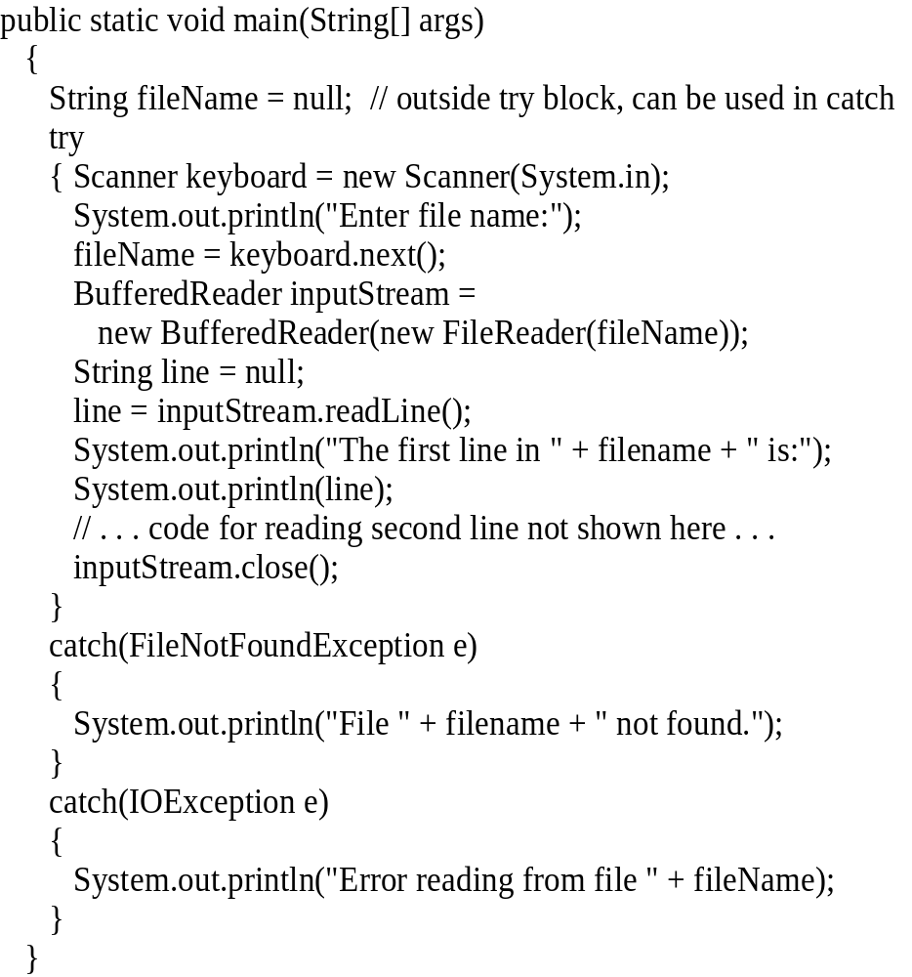
Example:
Reading a File Name from the Keyboard
reading a file name from the keyboard
using the file name read from the keyboard
closing the file
reading data from the file
Chapter 10
Java: an Introduction to Computer Science & Programming - Walter Savitch

Slide 29
Exception.getMessage()
try
{
…
}
catch (FileNotFoundException e)
{
System.out.println(filename + “ not found”);
System.out.println(“Exception: “ +
e.getMessage());
System.exit(-1);
}

Slide 30
Reading Words in a String:
Using StringTokenizer Class
There are BufferedReader methods to read a line and a character, but not just a single word
StringTokenizer can be used to parse a line into words
  import java.util.*
  some of its useful methods are shown in the text
    e.g. test if there are more tokens
  you can specify delimiters (the character or characters that separate words)
    the default delimiters are "white space" (space, tab, and newline)

Slide 31
Example: StringTokenizer
Display the words separated by any of the following characters: space, new line (\n), period (.) or comma (,).
String inputLine = keyboard.nextLine();
StringTokenizer wordFinder =
new StringTokenizer(inputLine, " \n.,");
//the second argument is a string of the 4 delimiters
while(wordFinder.hasMoreTokens())
{
System.out.println(wordFinder.nextToken());
}
Question
2b
or
!tooBee
Entering "Question,2b.or !tooBee." gives this output:

Slide 32
Testing for End of File in a Text File
When readLine tries to read beyond the end of a text file it returns the special value null
  so you can test for null to stop processing a text file
read returns -1 when it tries to read beyond the end of a text file
  the int value of all ordinary characters is nonnegative
Neither of these two methods (read and readLine) will throw an EOFException.

Slide 33
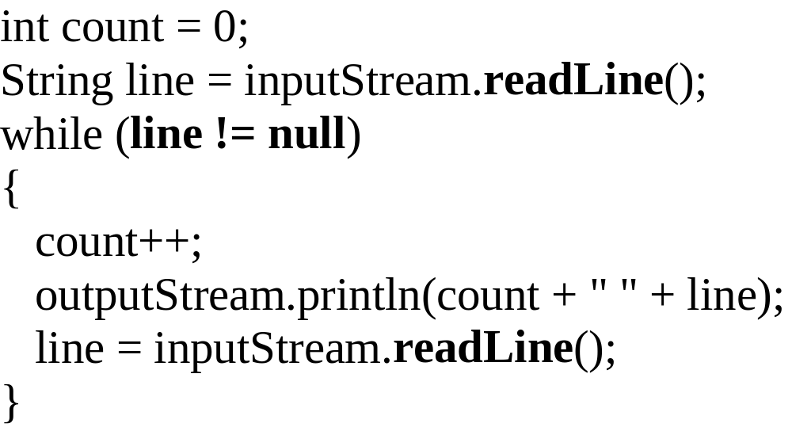
Example: Using Null to
Test for End-of-File in a Text File
When using readLine
test for null
Excerpt from TextEOFDemo
When using read test for -1
Chapter 9
Java: an Introduction to Computer Science & Programming - Walter Savitch

Slide 34
File I/O example
http://www.cs.fit.edu/~pkc/classes/cse1001/FileIO/FileIO.java

Slide 35
Using Path Names
Path name—gives name of file and tells which directory the file is in
Relative path name—gives the path starting with the directory that the program is in
Typical UNIX path name:
/user/smith/home.work/java/FileClassDemo.java
Typical Windows path name:
D:\Work\Java\Programs\FileClassDemo.java
When a backslash is used in a quoted string it must be written as two backslashes since backslash is the escape character:
"D:\\Work\\Java\\Programs\\FileClassDemo.java"
Java will accept path names in UNIX or Windows format, regardless of which operating system it is actually running on.

Slide 36
File Class [java.io]
Acts like a wrapper class for file names
A file name like "numbers.txt" has only String properties
File has some very useful methods
  exists: tests if a file already exists
  canRead: tests if the OS will let you read a file
  canWrite: tests if the OS will let you write to a file
  delete: deletes the file, returns true if successful
  length: returns the number of bytes in the file
  getName: returns file name, excluding the preceding path
  getPath: returns the path name—the full name
File numFile = new File(“numbers.txt”);
if (numFile.exists())
System.out.println(numfile.length());

Slide 37
File Objects and Filenames
FileInputStream and FileOutputStream have constructors that take a File argument as well as constructors that take a String argument
PrintWriter smileyOutStream = new PrintWriter(new FileOutputStream(“smiley.txt”));
File smileyFile = new File(“smiley.txt”);
if (smileyFile.canWrite())
PrintWriter smileyOutStream = new PrintWriter(new FileOutputStream(smileyFile));

Slide 38
Alternative with Scanner
Instead of BufferedReader with FileReader, then StringTokenizer
Use Scanner with File:
Scanner inFile =
new Scanner(new File(“in.txt”));
Similar to Scanner with System.in:
Scanner keyboard =
new Scanner(System.in);

Slide 39
Reading in int’s
Scanner inFile = new Scanner(new File(“in.txt"));
int number;
while (inFile.hasInt())
{
number = inFile.nextInt();
// …
}

Slide 40
Reading in lines of characters
Scanner inFile = new Scanner(new File(“in.txt"));
String line;
while (inFile.hasNextLine())
{
line = inFile.nextLine();
// …
}

Slide 41
Multiple types on one line
// Name, id, balance
Scanner inFile = new Scanner(new File(“in.txt"));
while (inFile.hasNext())
{
name = inFile.next();
id = inFile.nextInt();
balance = inFile.nextFloat();
// … new Account(name, id, balance);
}
--------------------
String line;
while (inFile.hasNextLine())
{
line = inFile.nextLine();
Scanner parseLine = new Scanner(line) // Scanner again!
name = parseLine.next();
id = parseLine.nextInt();
balance = parseLine.nextFloat();
// … new Account(name, id, balance);
}

Slide 42
Multiple types on one line
// Name, id, balance
Scanner inFile = new Scanner(new File(“in.txt"));
String line;
while (inFile.hasNextLine())
{
line = inFile.nextLine();
Account account = new Account(line);
}
--------------------
public Account(String line) // constructor
{
Scanner accountLine = new Scanner(line);
_name = accountLine.next();
_id = accountLine.nextInt();
_balance = accountLine.nextFloat();
}

Slide 43
BufferedReader vs Scanner
(parsing primitive types)
Scanner
  nextInt(), nextFloat(), … for parsing types
BufferedReader
  read(), readLine(), … none for parsing types
  needs StringTokenizer then wrapper class methods like Integer.parseInt(token)

Slide 44
BufferedReader vs Scanner
(Checking End of File/Stream (EOF))
BufferedReader
  readLine() returns null
  read() returns -1
Scanner
  nextLine() throws exception
  needs hasNextLine() to check first
  nextInt(), hasNextInt(), …

Slide 45
BufferedReader inFile = …
line = inFile.readline();
while (line != null)
{
// …
line = inFile.readline();
}
-------------------
Scanner inFile = …
while (inFile.hasNextLine())
{
line = infile.nextLine();
// …
}

Slide 46
BufferedReader inFile = …
line = inFile.readline();
while (line != null)
{
// …
line = inFile.readline();
}
-------------------
BufferedReader inFile = …
while ((line = inFile.readline()) != null)
{
// …
}

Slide 47
My suggestion
Use Scanner with File
  new Scanner(new File(“in.txt”))
Use hasNext…() to check for EOF
  while (inFile.hasNext…())
Use next…() to read
  inFile.next…()
Simpler and you are familiar with methods for Scanner

Slide 48
My suggestion cont…
File input
  Scanner inFile =
  new Scanner(new File(“in.txt”));
File output
  PrintWriter outFile =
  new PrintWriter(new File(“out.txt”));
  outFile.print(), println(), format(), flush(), close(), …
http://www.cs.fit.edu/~pkc/classes/cse1001/FileIO/FileIONew.java

Slide 49
Skipping binary file I/O for now; if we have time, we’ll come back

Slide 50
Basic Binary File I/O
Important classes for binary file output (to the file)
  ObjectOutputStream
  FileOutputStream
Important classes for binary file input (from the file):
  ObjectInputStream
  FileInputStream
Note that FileOutputStream and FileInputStream are used only for their constructors, which can take file names as arguments.
  ObjectOutputStream and ObjectInputStream cannot take file names as arguments for their constructors.
To use these classes your program needs a line like the following:
  import java.io.*;

Slide 51
Java File I/O: Stream Classes
ObjectInputStream and ObjectOutputStream:
  have methods to either read or write data one byte at a time
  automatically convert numbers and characters into binary
    binary-encoded numeric files (files with numbers) are not readable by a text editor, but store data more efficiently
Remember:
  input means data into a program, not the file
  similarly, output means data out of a program, not the file

Slide 52
When Using ObjectOutputStream to Output Data to Files:
The output files are binary and can store any of the primitive data types (int, char, double, etc.) and the String type
The files created can be read by other Java programs but are not printable
The Java I/O library must be imported by including the line:
import java.io.*;
  it contains ObjectOutputStream and other useful class definitions
An IOException might be thrown

Slide 53
Handling IOException
IOException cannot be ignored
  either handle it with a catch block
  or defer it with a throws-clause
We will put code to open the file and write to it in a try-block and write a catch-block for this exception :
catch(IOException e)
{
System.out.println("Problem with output...";
}

Slide 54
Opening a New Output File
The file name is given as a String
  file name rules are determined by your operating system
Opening an output file takes two steps
  1. Create a FileOutputStream object associated with the file name String
  Connect the FileOutputStream to an ObjectOutputStream object
  This can be done in one line of code

Slide 55
Example: Opening an Output File
To open a file named numbers.dat:
  ObjectOutputStream outputStream =
  new ObjectOutputStream(
  new FileOutputStream("numbers.dat"));
The constructor for ObjectOutputStream requires a FileOutputStream argument
The constructor for FileOutputStream requires a String argument
  the String argument is the output file name
The following two statements are equivalent to the single statement above:
  FileOutputStream middleman =
  new FileOutputStream("numbers.dat");
  ObjectOutputStream outputStream =
  new ObjectOutputSteam(middleman);

Slide 56
Some ObjectOutputStream Methods
You can write data to an output file after it is connected to a stream class
  Use methods defined in ObjectOutputStream
    writeInt(int n)
    writeDouble(double x)
    writeBoolean(boolean b)
    etc.
    See the text for more
Note that each write method throws IOException
  eventually we will have to write a catch block for it
Also note that each write method includes the modifier final
  final methods cannot be redefined in derived classes

Slide 57
Closing a File
An Output file should be closed when you are done writing to it
Use the close method of the class ObjectOutputStream
For example, to close the file opened in the previous example:
  outputStream.close();
If a program ends normally it will close any files that are open

Slide 58
Writing a Character to a File: an Unexpected Little Complexity
The method writeChar has an annoying property:
  it takes an int, not a char, argument
But it is easy to fix:
  just cast the character to an int
For example, to write the character 'A' to the file opened previously:
  outputStream.writeChar((int) 'A');
Or, just use the automatic conversion from char to int

Slide 59
Writing a boolean Value to a File
boolean values can be either of two values, true or false
true and false are not just names for the values, they actually are of type boolean
For example, to write the boolean value false to the output file:
  outputStream.writeBoolean(false);

Slide 60
Writing Strings to a File:
Another Little Unexpected Complexity
Use the writeUTF method to output a value of type String
  there is no writeString method
UTF stands for Unicode Text Format
  a special version of Unicode
Unicode: a text (printable) code that uses 2 bytes per character
  designed to accommodate languages with a different alphabet or no alphabet (such as Chinese and Japanese)
ASCII: also a text (printable) code, but it uses just 1 byte per character
  the most common code for English and languages with a similar alphabet
UTF is a modification of Unicode that uses just one byte for ASCII characters
  allows other languages without sacrificing efficiency for ASCII files

Slide 61
When Using ObjectInputStream to Read Data from Files:
Input files are binary and contain any of the primitive data types (int, char, double, etc.) and the String type
The files can be read by Java programs but are not printable
The Java I/O library must be imported including the line:
import java.io.*;
  it contains ObjectInputStream and other useful class definitions
An IOException might be thrown

Slide 62
Opening a New Input File
Similar to opening an output file, but replace "output" with "input"
The file name is given as a String
  file name rules are determined by your operating system
Opening a file takes two steps
  1. Creating a FileInputStream object associated with the file name String
  2. Connecting the FileInputStream to an ObjectInputStream object
This can be done in one line of code

Slide 63
Example: Opening an Input File
To open a file named numbers.dat:
  ObjectInputStream inStream =
  new ObjectInputStream (new FileInputStream("numbers.dat"));
The constructor for ObjectInputStream requires a FileInputStream argument
The constructor for FileInputStream requires a String argument
  the String argument is the input file name
The following two statements are equivalent to the statement at the top of this slide:
  FileInputStream middleman =
  new FileInputStream("numbers.dat");
  ObjectInputStream inputStream =
  new ObjectInputStream (middleman);

Slide 64
Some ObjectInputStream Methods
For every output file method there is a corresponding input file method
You can read data from an input file after it is connected to a stream class
  Use methods defined in ObjectInputStream
    readInt()
    readDouble()
    readBoolean()
    etc.
    See the text for more
Note that each write method throws IOException
Also note that each write method includes the modifier final

Slide 65
Input File Exceptions
A FileNotFoundException is thrown if the file is not found when an attempt is made to open a file
Each read method throws IOException
  we still have to write a catch block for it
If a read goes beyond the end of the file an EOFException is thrown

Slide 66
Avoiding Common ObjectInputStream File Errors
There is no error message (or exception)
if you read the wrong data type!
Input files can contain a mix of data types
  it is up to the programmer to know their order and use the correct read method
ObjectInputStream works with binary, not text files
As with an output file, close the input file when you are done with it

Slide 67
Common Methods to Test for the End of an Input File
A common programming situation is to read data from an input file but not know how much data the file contains
In these situations you need to check for the end of the file
There are three common ways to test for the end of a file:
  1. Put a sentinel value at the end of the file and test for it.
  2. Throw and catch an end-of-file exception.
  3. Test for a special character that signals the end of the file (text files often have such a character).

Slide 68
The EOFException Class
Many (but not all) methods that read from a file throw an end-of-file exception (EOFException) when they try to read beyond the file
  all the ObjectInputStream methods in Display 9.3 do throw it
The end-of-file exception can be used in an "infinite" (while(true)) loop that reads and processes data from the file
  the loop terminates when an EOFException is thrown
The program is written to continue normally after the EOFException has been caught

Slide 69
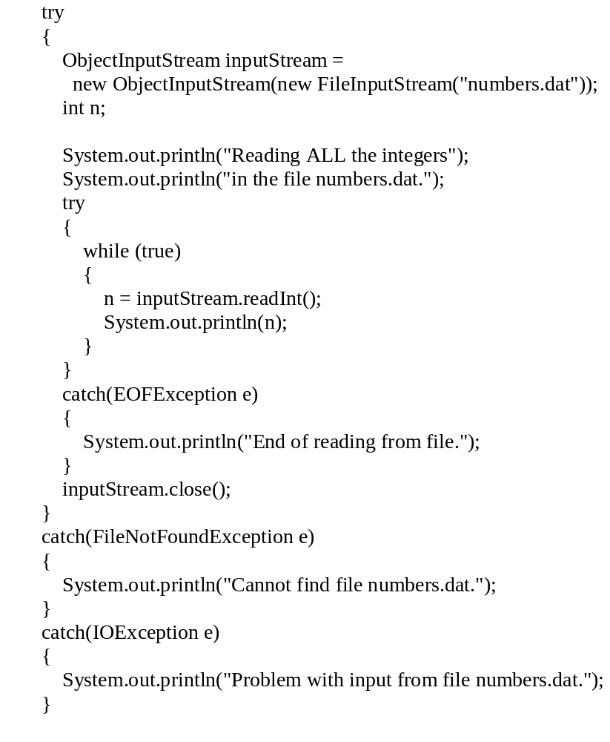
Using EOFException
main method from
EOFExceptionDemo
Intentional "infinite" loop to process data from input file
Loop exits when end-of-file exception is thrown
Processing continues after EOFException: the input file is closed
Note order of catch blocks:
the most specific is first
and the most general last
Chapter 9
Java: an Introduction to Computer Science & Programming - Walter Savitch

Slide 70
Binary I/O of Class Objects
read and write class objects in binary file
class must be serializable
  import java.io.*
  implement Serializable interface
  add implements Serializable to heading of class definition
methods used:
public class Species implements Serializable
to write object to file:
writeObject method in ObjectOutputStream
to read object from file: readObject method in ObjectInputStream

Slide 71
outputStream = new ObjectOutputStream(
new FileOutputStream("species.records"));
...
Species oneRecord =
new Species("Calif. Condor, 27, 0.02);
...
outputStream.writeObject(oneRecord);
ClassIODemo Excerpts
inputStream = new ObjectInputStream(
new FileInputStream("species.records"));
...
Species readOne = null;
...
readOne = (Species)inputStream.readObject(oneRecord);
readObject returns a reference to type Object so it must be cast to Species before assigning to readOne

Slide 72
The Serializable Interface
Java assigns a serial number to each object written out.
  If the same object is written out more than once, after the first write only the serial number will be written.
  When an object is read in more than once, then there will be more than one reference to the same object.
If a serializable class has class instance variables then they should also be serializable.
Why aren't all classes made serializable?
  security issues: serial number system can make it easier for programmers to get access to object data
  doesn't make sense in all cases, e.g., system-dependent data

Slide 73
Summary
Part 1
Text files contain strings of printable characters; they look intelligible to humans when opened in a text editor.
Binary files contain numbers or data in non-printable codes; they look unintelligible to humans when opened in a text editor.
Java can process both binary and text files, but binary files are more common when doing file I/O.
The class ObjectOutputStream is used to write output to a binary file.

Slide 74
Summary
Part 2
The class ObjectInputStream is used to read input from a binary file.
Always check for the end of the file when reading from a file. The way you check for end-of-file depends on the method you use to read from the file.
A file name can be read from the keyboard into a String variable and the variable used in place of a file name.
The class File has methods to test if a file exists and if it is read- and/or write-enabled.
Serializable class objects can be written to a binary file.

